Slide 1
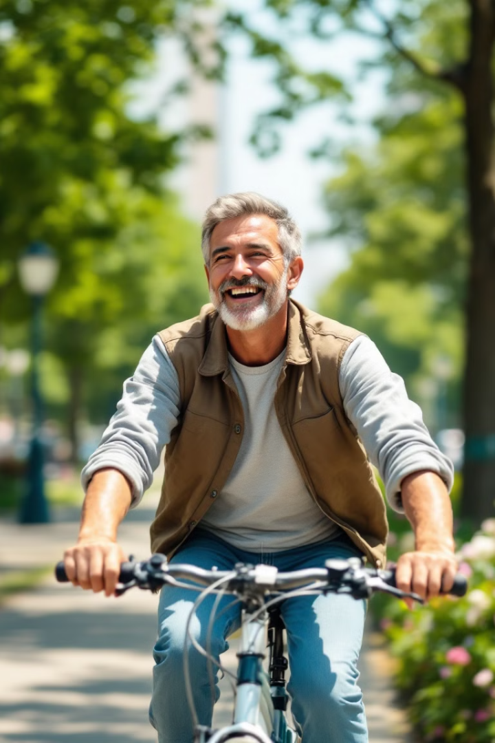

Unlocking Cyclistic's Potential: Understanding Rider Behaviour for Membership Conversion
By Shreyash Sahare

Slide 2
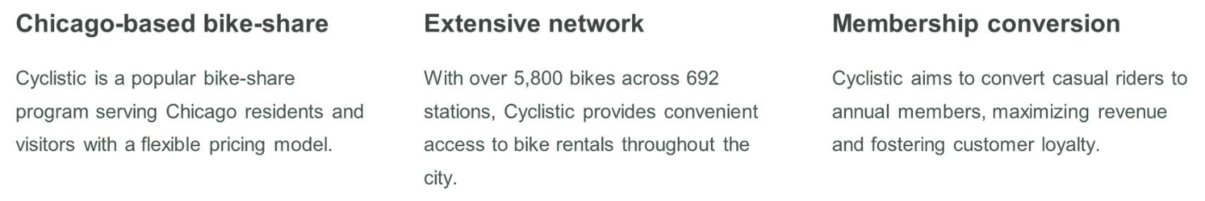
About Cyclistic

Slide 3
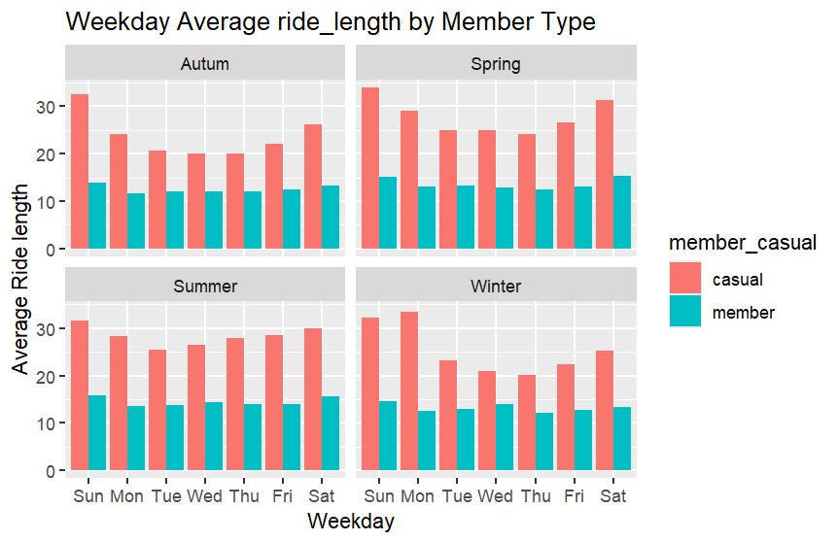
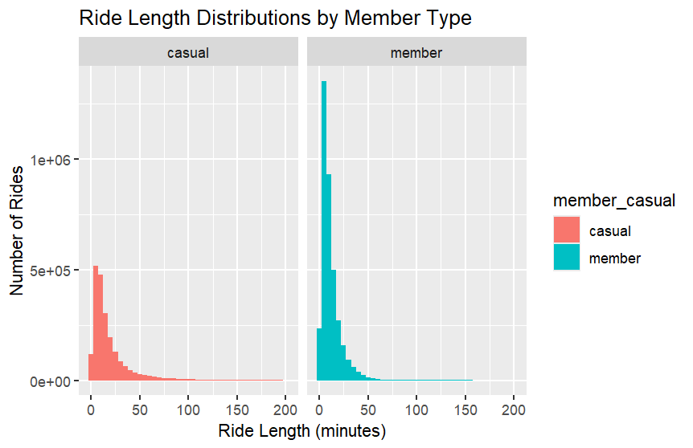
Understanding Casual
Rider Behavior
Ride Length
Casual riders take longer rides (20-30 minutes) than annual members (10-15 minutes) across all seasons, indicating a focus on leisure and exploration.
Ride Frequency
Annual members ride more frequently than casual riders, indicating a consistent usage pattern, likely for commuting or quick errands.

Slide 4
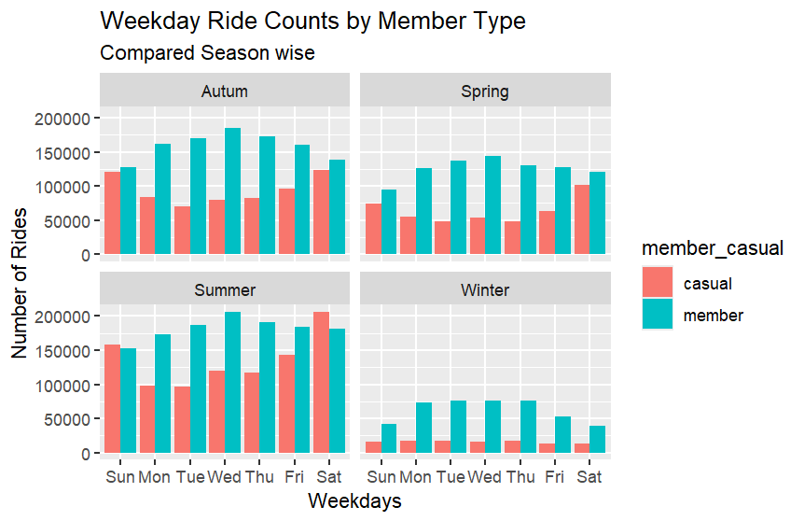
Seasonal and Day-of-Week Trends
Peak Seasons
Ride counts for both member types peak in Summer and Autumn, driven by favorable weather.
Weekday Usage
Casual riders peak on weekends, aligning with leisure activities, while members have consistent weekday usage, supporting commuting.

Slide 5
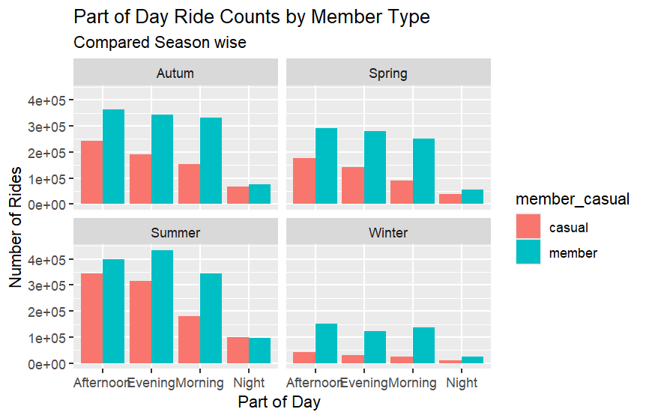
Time-of-Day Usage Patterns
Afternoon is the busiest time for rides for both casual and annual members.
1
2
Casual riders also show significant evening and morning usage, particularly during peak seasons.
3
Annual members maintain a consistent usage throughout the day, reflecting commuting patterns.

Slide 6

Key Takeaways
Ride Length
Ride Frequency
Casual riders enjoy longer rides for leisure, while members favor short trips for commuting or errands.
Annual members ride more frequently, suggesting regular usage, while casual riders have more sporadic usage.
Peak Times
Afternoon is the busiest time for both member types, with casual riders also showing significant evening and morning usage.

Slide 7
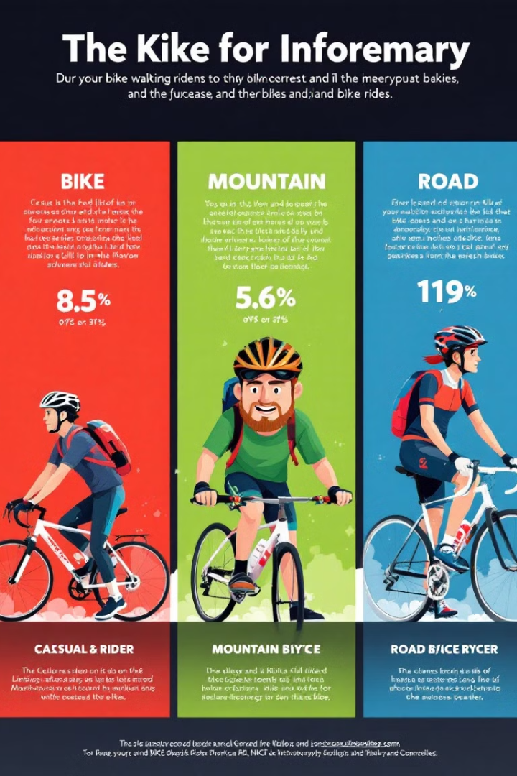



Tiered Membership Options
Explorer
Weekend Warrior
Frequent Rider
For longer rides, offering discounted rates for extended durations and potentially bundled with a limited number of shorter rides.
Geared towards ride frequency, offering discounted rates for a set number of rides per month, catering to both short and medium-length trips.
Provides discounted access on weekends, targeting leisure riders, with options for both short and long rides.

Slide 8
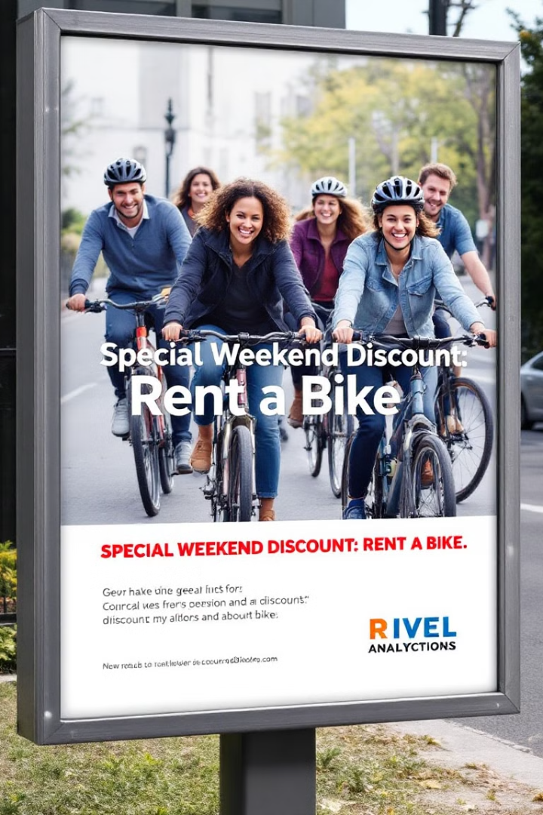
Targeted Marketing Strategies
1
Run Summer and Autumn-focused campaigns showcasing the joy of recreational riding and the convenience of quick trips.
2
Offer weekend-specific discounts or challenges through social media and email marketing, highlighting both long scenic routes and quick trip options.
3
Utilize online advertising platforms to target casual riders during afternoons and evenings, with messaging tailored to their likely ride purpose.

Slide 9

Conclusion
Converting casual riders to annual members is crucial for Cyclistic's sustained growth. By understanding casual rider needs and preferences, targeted strategies can effectively drive conversions. Pilot programs and A/B testing should be implemented to refine and optimize the proposed recommendations.

